Slide 1

CS4225/CS5425 Big Data Systems for Data Science
Spark I: Basics
Ai Xin
School of Computing
National University of Singapore
aixin@comp.nus.edu.sg

Slide 2
Intro
Lecturer: Ai Xin
Email: aixin@comp.nus.edu.sg
Office Hours: 2-3pm on 20 Oct, 3, 17 and 24 Nov at COM3-B1-24
TAs
Assignment 2 (Post to Canvas/Discussion or Email TAs)
SIDDARTH NANDANAHOSUR SURESH (Name A-G)
TAN TZE YEONG (Name H-L)
TAN YAN RONG AMELIA (Name L-R)
TENG YI SHIONG (Name R-W)
TOH WEI JIE (Name W-Z)
Tutorial and Lecture (Post to Canvas/Discussion or Email TAs)
ZHANG JIHAI (week 7 – 9)
GOH TECK LUN (conduct tutorials)
Hu Zhiyuan (week 10 – 13)
Notes:
Siddarth Nandanahosur Suresh <siddarth.suresh@u.nus.edu>;
Tan Tze Yeong <e0555970@u.nus.edu>;
Tan Yan Rong Amelia <amelia_tan@u.nus.edu>;
Teng Yi Shiong <teng_yi_shiong@u.nus.edu>;
Toh Wei Jie <e0564630@u.nus.edu>;
Zhang Jihai <e0792476@u.nus.edu>;
Goh Teck Lun <e0431596@u.nus.edu>;
Zhiyuan Hu <zhiyuan_hu@u.nus.edu>;

Slide 3
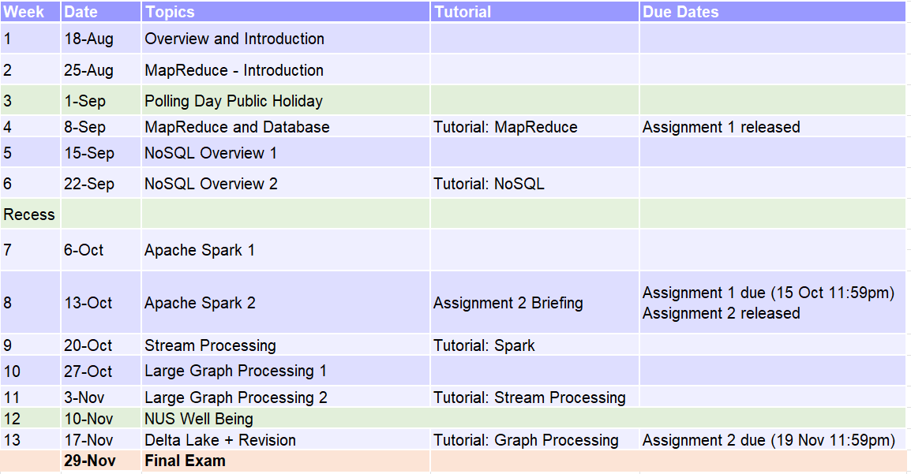
Schedule

Slide 4
Today’s Plan
Introduction and Basics
Working with RDDs
Caching and DAGs
DataFrames and Datasets

Slide 5
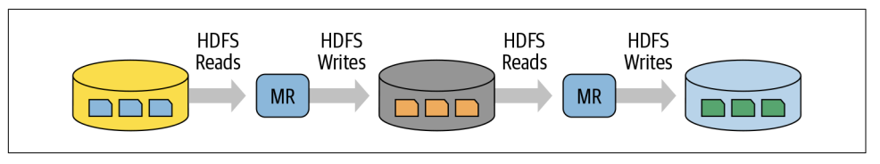
Motivation: Hadoop vs Spark
Issues with Hadoop Mapreduce:
Network and disk I/O costs: intermediate data has to be written to local disks and shuffled across machines, which is slow
Not suitable for iterative (i.e. modifying small amounts of data repeatedly) processing, such as interactive workflows, as each individual step has to be modelled as a MapReduce job.
Spark stores most of its intermediate results in memory, making it much faster, especially for iterative processing
When memory is insufficient, Spark spills to disk which requires disk I/O

Slide 6
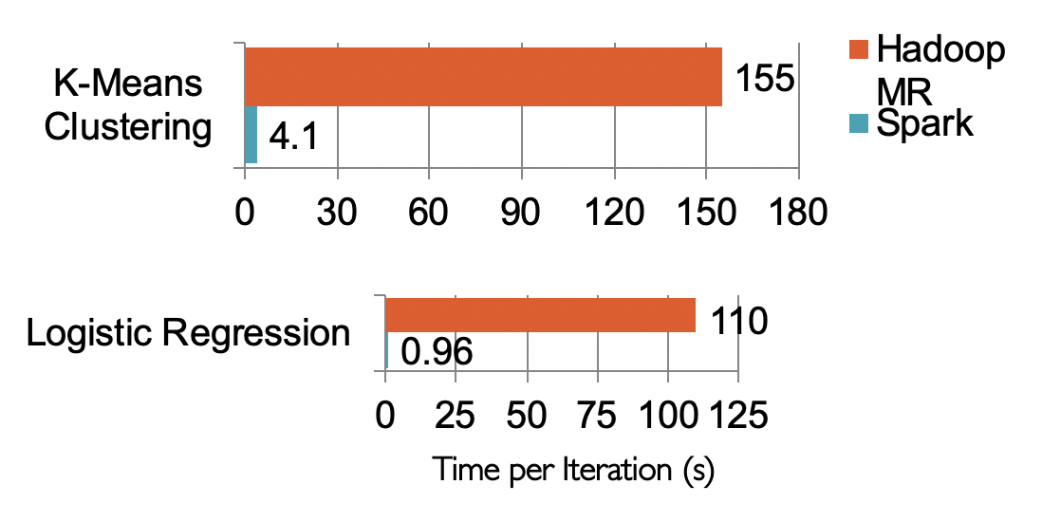
Performance Comparison

Slide 7
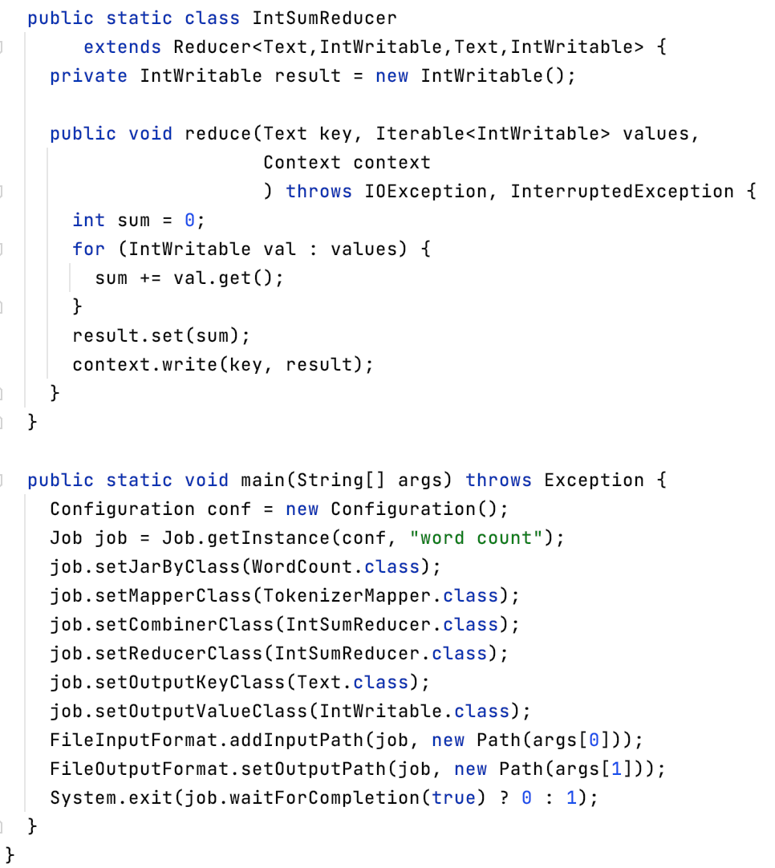
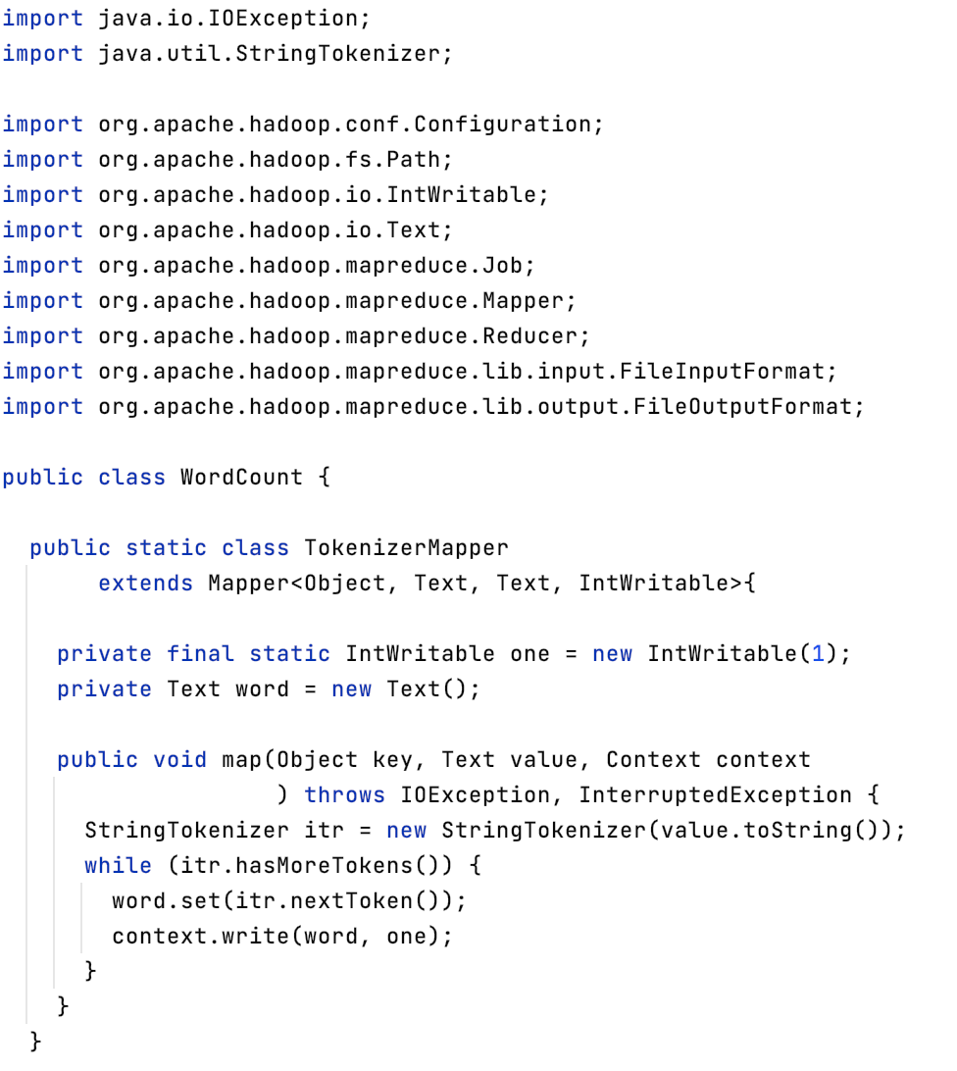
Ease of Programmability
WordCount (Hadoop MapReduce)

Slide 8
Ease of Programmability
val file = sc.textFile(“hdfs://...”)
val counts = file.flatMap(line => line.split(“ ”)) .map(word => (word, 1)) .reduceByKey(_ + _) counts.save(“...”)
WordCount (Spark)

Slide 9
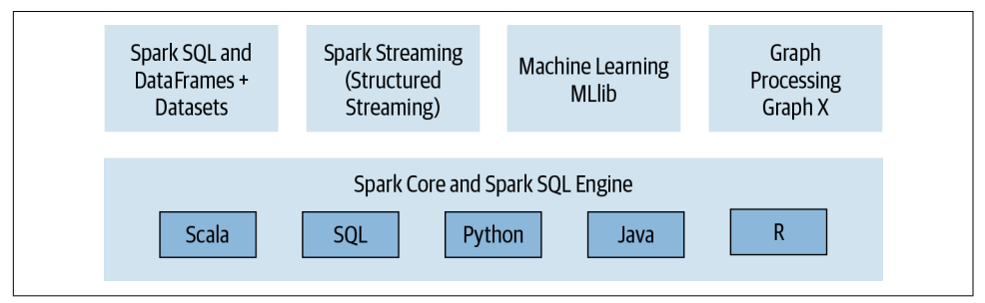
Spark Components and API Stack

Slide 10
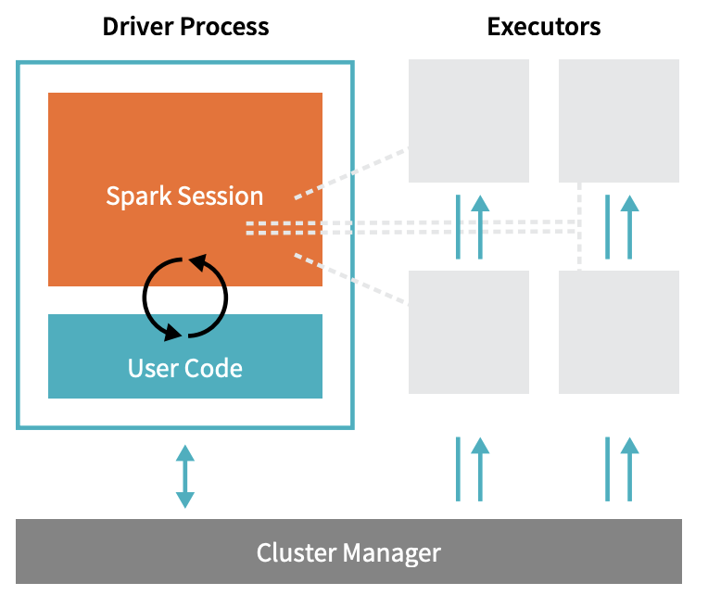
Spark Architecture
Driver Process responds to user input, manages the Spark application etc., and distributes work to Executors, which run the code assigned to them and send the results back to the driver
Cluster Manager (can be Spark’s standalone cluster manager, YARN, Mesos or Kubernetes) allocates resources when the application requests it
In local mode, all these processes run on the same machine

Slide 11
Evolution of Spark APIs
Resilient Distributed Datasets
(2011)
DataFrame
(2013)
DataSet
(2013)
A collection of JVM objects
Functional operators (map, filter, etc)
A collection of Row objects
Expression-based operations
Logical plans and optimizer
Internally rows, externally JVM objects.
Almost the "Best of both worlds": type safe + fast
Notes:
Spark achieves simplicity by providing a fundamental abstraction of a simple logical data structure called a Resilient Distributed Dataset (RDD) upon which all other
higher-level structured data abstractions, such as DataFrames and Datasets, are constructed. By providing a set of transformations and actions as operations, Spark offers
a simple programming model that you can use to build big data applications in familiar languages.
RDD
A distributed collection of JVM objects
Functional operation (map, filter, etc)
DataFrame
A distributed collection of rows with the same schema
Each row is a generic untyped JVM object (Row) which may hold different types of fields
Expression-based relational operations (join, GroupBy)
Logical plans and optimizer
DataSet
Very Similar to DataFrame
Each row is a strongly typed JVM object
Type-safety
Customized operations

Slide 12
Today’s Plan
Introduction and Basics
Working with RDDs
Caching and DAGs
DataFrames and Datasets

Slide 13
Resilient Distributed Datasets (RDDs)
Represent a collection of objects that is distributed over machines
Achieve fault tolerance through lineages

Slide 14

RDD: Distributed Data
# Create an RDD of names, distributed over 3 partitions
dataRDD = sc.parallelize(["Alice", "Bob", "Carol", "Daniel"], 3)
Partition data into 3 parts
Worker
Driver
[Alice,
Bob]
RDDs are immutable, i.e. they cannot be changed once created.
This is an RDD with 4 strings. In actual hardware, it will be partitioned into the 3 workers.
Worker
Worker
[Carol]
[Daniel]

Slide 15

Transformations
Transformations are a way of transforming RDDs into RDDs.
# Create an RDD: length of names
dataRDD = sc.parallelize(["Alice", "Bob", "Carol", "Daniel"], 3)
nameLen = dataRDD.map(lambda s: len(s))
This represents the transformation that maps each string to its length, creating a new RDD.
However, transformations are lazy. This means the transformation will not be executed yet, until an action is called on it
Q: what are the advantages of being lazy?
A: Spark can optimize the query plan to improve speed (e.g. removing unneeded operations)
Examples of transformations: map, order, groupBy, filter, join, select

Slide 16
Actions
Actions trigger Spark to compute a result from a series of transformations.
dataRDD = sc.parallelize(["Alice", "Bob", "Carol", "Daniel"], 3)
nameLen = dataRDD.map(lambda s: len(s))
nameLen.collect()
[5, 3, 5, 6]
collect() here is an action.
It is the action that asks Spark to retrieve all elements of the RDD to the driver node.
Examples of actions: show, count, save, collect

Slide 17
Distributed Processing
# Create an RDD: length of names
dataRDD = sc.parallelize(["Alice", "Bob", "Carol", "Daniel"], 3)
nameLen = dataRDD.map(lambda s: len(s))
nameLen.collect()
As we previously said, RDDs are actually distributed across machines.
Thus, the transformations and actions are executed in parallel. The results are only sent to the driver in the final step.
Worker
Driver
[Alice,
Bob]
Worker
Worker
[Carol]
[Daniel]

Slide 18
Distributed Processing
# Create an RDD: length of names
dataRDD = sc.parallelize(["Alice", "Bob", "Carol", "Daniel"], 3)
nameLen = dataRDD.map(lambda s: len(s))
nameLen.collect()
As we previously said, RDDs are actually distributed across machines.
Thus, the transformations and actions are executed in parallel. The results are only sent to the driver in the final step.
Worker
Driver
[Alice,Bob]
map
[5, 3]
Worker
Worker
map
[Carol]
[5]
map
[Daniel]
[6]

Slide 19
Distributed Processing
# Create an RDD: length of names
dataRDD = sc.parallelize(["Alice", "Bob", "Carol", "Daniel"], 3)
nameLen = dataRDD.map(lambda s: len(s))
nameLen.collect()
As we previously said, RDDs are actually distributed across machines.
Thus, the transformations and actions are executed in parallel. The results are only sent to the driver in the final step.
Worker
Driver
collect
[5, 3]
Worker
Worker
[5]
[6]

Slide 20
Distributed Processing
# Create an RDD: length of names
dataRDD = sc.parallelize(["Alice", "Bob", "Carol", "Daniel"], 3)
nameLen = dataRDD.map(lambda s: len(s))
nameLen.collect()
As we previously said, RDDs are actually distributed across machines.
Thus, the transformations and actions are executed in parallel. The results are only sent to the driver in the final step.
Worker
[5, 3, 5, 6]
Driver
collect
[5, 3]
Worker
Worker
[5]
[6]

Slide 21
Working with RDDs
Note: this reads the file on each worker node in parallel, not on the driver node
textFile = sc.textFile(”File.txt”)
RDD
Action
RDD
Transformations
RDD
Value
RDD
linesWithSpark.count()
74
linesWithSpark.first()
# Apache Spark
linesWithSpark = textFile.filter(lambda line: "Spark” in line)

Slide 22
Today’s Plan
Introduction and Basics
Working with RDDs
Caching and DAGs
DataFrames and Datasets

Slide 23
Caching
Log Mining example: Load error messages from a log into memory, then interactively search for various patterns
lines = sc.textFile(“hdfs://...”)
errors = lines.filter(lambda s: s.startswith(“ERROR”))
messages = errors.map(lambda s: s.split(“\t”)[2])
messages.cache()
Worker
Driver
messages.filter(lambda s: “mysql” in s).count()
Worker
Worker

Slide 24
Caching
Log Mining example: Load error messages from a log into memory, then interactively search for various patterns
lines = sc.textFile(“hdfs://...”)
errors = lines.filter(lambda s: s.startswith(“ERROR”))
messages = errors.map(lambda s: s.split(“\t”)[2])
messages.cache()
Worker
Driver
Block 1
messages.filter(lambda s: “mysql” in s).count()
Worker
Worker
Block 2
Block 3

Slide 25
Caching
Log Mining example: Load error messages from a log into memory, then interactively search for various patterns
lines = sc.textFile(“hdfs://...”)
errors = lines.filter(lambda s: s.startswith(“ERROR”))
messages = errors.map(lambda s: s.split(“\t”)[2])
messages.cache()
Worker
Driver
tasks
Block 1
tasks
messages.filter(lambda s: “mysql” in s).count()
tasks
Worker
Worker
Block 2
Block 3

Slide 26
Caching
Log Mining example: Load error messages from a log into memory, then interactively search for various patterns
lines = sc.textFile(“hdfs://...”)
errors = lines.filter(lambda s: s.startswith(“ERROR”))
messages = errors.map(lambda s: s.split(“\t”)[2])
messages.cache()
Worker
Driver
Block 1
Read
HDFS
Block
messages.filter(lambda s: “mysql” in s).count()
Worker
Worker
Read HDFS
Block
Block 2
Read HDFS
Block
Block 3

Slide 27
Caching
Log Mining example: Load error messages from a log into memory, then interactively search for various patterns
Cache 1
lines = sc.textFile(“hdfs://...”)
errors = lines.filter(lambda s: s.startswith(“ERROR”))
messages = errors.map(lambda s: s.split(“\t”)[2])
messages.cache()
Worker
Driver
Block 1
Process & Cache
Data
messages.filter(lambda s: “mysql” in s).count()
Cache 2
Worker
Cache 3
Worker
Process & Cache
Data
Block 2
Process & Cache
Data
Block 3

Slide 28
Caching
Log Mining example: Load error messages from a log into memory, then interactively search for various patterns
Cache 1
lines = sc.textFile(“hdfs://...”)
errors = lines.filter(lambda s: s.startswith(“ERROR”))
messages = errors.map(lambda s: s.split(“\t”)[2])
messages.cache()
Worker
results
Block 1
Driver
results
messages.filter(lambda s: “mysql” in s).count()
Cache 2
results
Worker
Cache 3
Worker
Block 2
Block 3

Slide 29
Caching
Log Mining example: Load error messages from a log into memory, then interactively search for various patterns
Cache 1
lines = sc.textFile(“hdfs://...”)
errors = lines.filter(lambda s: s.startswith(“ERROR”))
messages = errors.map(lambda s: s.split(“\t”)[2])
messages.cache()
Worker
Driver
Block 1
messages.filter(lambda s: “mysql” in s).count()
Cache 2
messages.filter(lambda s: “php” in s).count()
Worker
Cache 3
Worker
Block 2
Block 3

Slide 30
Caching
Log Mining example: Load error messages from a log into memory, then interactively search for various patterns
Cache 1
lines = sc.textFile(“hdfs://...”)
errors = lines.filter(lambda s: s.startswith(“ERROR”))
messages = errors.map(lambda s: s.split(“\t”)[2])
messages.cache()
Worker
Driver
tasks
Block 1
tasks
messages.filter(lambda s: “mysql” in s).count()
Cache 2
tasks
Worker
messages.filter(lambda s: “php” in s).count()
Cache 3
Worker
Block 2
Block 3

Slide 31
Caching
Log Mining example: Load error messages from a log into memory, then interactively search for various patterns
Cache 1
lines = sc.textFile(“hdfs://...”)
errors = lines.filter(lambda s: s.startswith(“ERROR”))
messages = errors.map(lambda s: s.split(“\t”)[2])
messages.cache()
Worker
Driver
Block 1
Process from Cache
messages.filter(lambda s: “mysql” in s).count()
Cache 2
messages.filter(lambda s: “php” in s).count()
Worker
Cache 3
Worker
Process from Cache
Block 2
Process from Cache
Block 3

Slide 32
Caching
Log Mining example: Load error messages from a log into memory, then interactively search for various patterns
Cache 1
lines = sc.textFile(“hdfs://...”)
errors = lines.filter(lambda s: s.startswith(“ERROR”))
messages = errors.map(lambda s: s.split(“\t”)[2])
messages.cache()
Worker
results
Block 1
Driver
results
messages.filter(lambda s: “mysql” in s).count()
Cache 2
results
Worker
messages.filter(lambda s: “php” in s).count()
Cache 3
Worker
Block 2
Block 3

Slide 33
Caching
Log Mining example: Load error messages from a log into memory, then interactively search for various patterns
Cache 1
lines = sc.textFile(“hdfs://...”)
errors = lines.filter(lambda s: s.startswith(“ERROR”))
messages = errors.map(lambda s: s.split(“\t”)[2])
messages.cache()
Worker
Driver
Block 1
messages.filter(lambda s: “mysql” in s).count()
Cache 2
messages.filter(lambda s: “php” in s).count()
Worker
Cache your data ➔ Faster Results
Full-text search of Wikipedia
60GB on 20 EC2 machines
0.5 sec from mem vs. 20s for on-disk
Cache 3
Worker
Block 2
Block 3

Slide 34
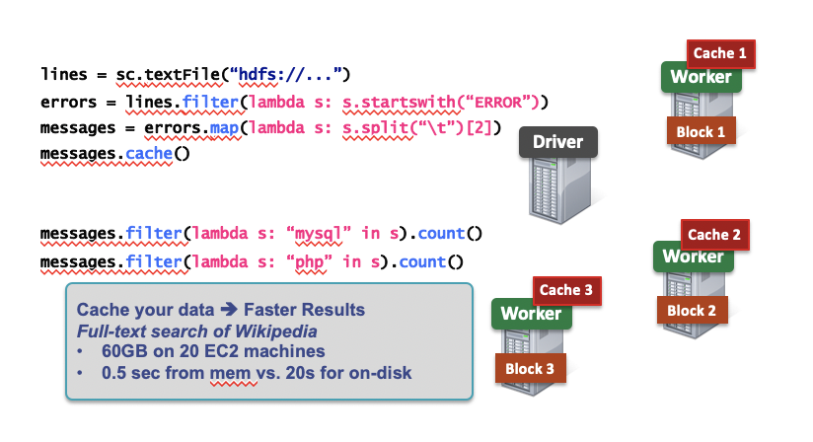
Caching
cache(): saves an RDD to memory (of each worker node).
persist(options): can be used to save an RDD to memory, disk, or off-heap memory
When should we cache or not cache an RDD?
When it is expensive to compute and needs to be re-used multiple times.
If worker nodes have not enough memory, they will evict the “least recently used” RDDs. So, be aware of memory limitations when caching.
Notes:
Off-heap memory offloads values to a storage area that is not subject to Java GC. By taking advantage of off-heap storage, an application can reduce the amount of heap storage that is subject to GC overhead. Off-heap memory works in conjunction with the heap, it does not replace it.

Slide 35
Directed Acyclic Graph (DAG)
Internally, Spark creates a graph (“directed acyclic graph”) which represents all the RDD objects and how they will be transformed.
Transformations construct this graph; actions trigger computations on it.
val file = sc.textFile(“hdfs://...”)
val counts = file.flatMap(line => line.split(“ ”)) .map(word => (word, 1)) .reduceByKey(_ + _) counts.save(“...”)
WordCount (Spark)

Slide 36
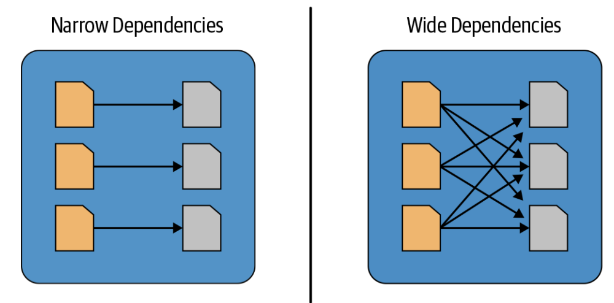
Narrow and Wide Dependencies
Narrow dependencies are where each partition of the parent RDD is used by at most 1 partition of the child RDD
E.g. map, flatMap, filter, contains
Wide dependencies are the opposite (each partition of parent RDD is used by multiple partitions of the child RDD)
E.g. reduceByKey, groupBy, orderBy
In the DAG, consecutive narrow dependencies are grouped together as “stages”.
Within stages, Spark performs consecutive transformations on the same machines.
Across stages, data needs to be shuffled, i.e. exchanged across partitions, in a process very similar to map-reduce, which involves writing intermediate results to disk
Minimizing shuffling is good practice for improving performance.
Notes:
wide transformations: data from other partitions is read in, combined, and written to disk.

Slide 37
Lineage and Fault Tolerance
Unlike Hadoop, Spark does not use replication to allow fault tolerance. Why?
Spark tries to store all the data in memory, not disk. Memory capacity is much more limited than disk, so simply duplicating all data is expensive.
Lineage approach: if a worker node goes down, we replace it by a new worker node, and use the graph (DAG) to recompute the data in the lost partition.
Note that we only need to recompute the RDDs from the lost partition.

Slide 38
Today’s Plan
Introduction and Basics
Working with RDDs
Caching and DAGs
DataFrames and Datasets

Slide 39
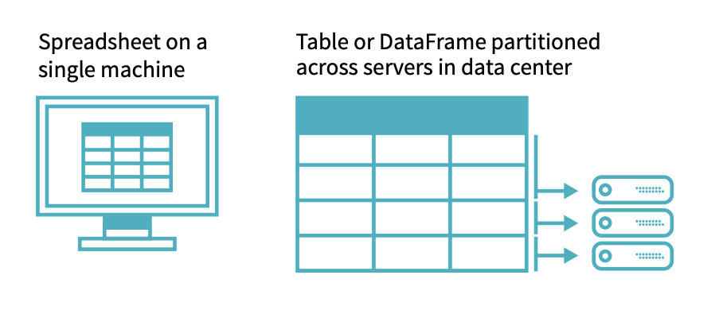
DataFrames
A DataFrame represents a table of data, similar to tables in SQL, or DataFrames in pandas.
Compared to RDDs, this is a higher level interface, e.g. it has transformations that resemble SQL operations.
DataFrames (and Datasets) are the recommended interface for working with Spark – they are easier to use than RDDs and almost all tasks can be done with them, while only rarely using the RDD functions.
However, all DataFrame operations are still ultimately compiled down to RDD operations by Spark.
Notes:
DataFrames can be constructed from tables from external data sources or from existing RDDs of native JVM objects.
Each DataFrame can also be viewed as an RDD of Row objects, allowing users to call procedural Spark APIs such as map.
Unlike RDDs, DataFrames keep track of their schema and support various relational operations that lead to more optimized execution.
DataFrame object represents a logical plan to compute a dataset, but no execution occurs until the user calls an action

Slide 40
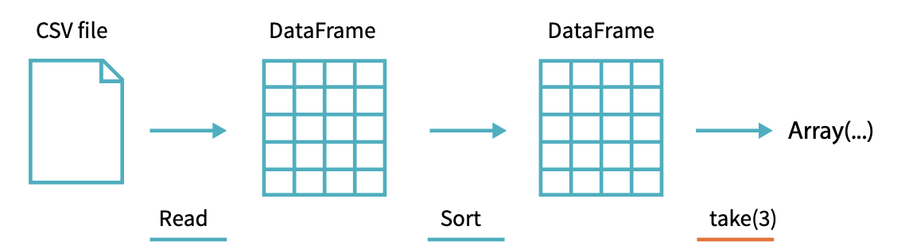
DataFrames: example
flightData2015 = spark\
.read\
.option("inferSchema", "true")\
.option("header", "true")\
.csv("/mnt/defg/flight-data/csv/2015-summary.csv")
Reads in a DataFrame from a CSV file.
flightData2015.sort("count").take(3)
Sorts by ‘count’ and output the first 3 rows (action)
Array([United States,Romania,15], [United States,Croatia...

Slide 41
DataFrames: transformations
An easy way to transform DataFrames is to use SQL queries. This takes in a DataFrame and returns a DataFrame (the output of the query).
flightData2015.createOrReplaceTempView("flight_data_2015")
maxSql = spark.sql("""
SELECT DEST_COUNTRY_NAME, sum(count) as destination_total
FROM flight_data_2015
GROUP BY DEST_COUNTRY_NAME
ORDER BY sum(count) DESC
LIMIT 5
""")
maxSql.collect()
Notes:
Apart from the relational DSL, DataFrames can be registered as
temporary tables in the system catalog and queried using SQL.

Slide 42
DataFrames: DataFrame interface
We can also run the exact same query as follows:
from pyspark.sql.functions import desc
flightData2015\
.groupBy("DEST_COUNTRY_NAME")\
.sum("count")\
.withColumnRenamed("sum(count)", "destination_total")\
.sort(desc("destination_total"))\
.limit(5)\
.collect()
Generally, these transformation functions (groupBy, sort, …) take in either strings or “column objects”, which represent columns.
For example, “desc” here returns a column object.

Slide 43
Datasets
Datasets are similar to DataFrames, but are type-safe.
In fact, in Spark (Scala), DataFrame is just an alias for Dataset[Row]
However, Datasets are not available in Python and R, since these are dynamically typed languages
case class Flight(DEST_COUNTRY_NAME: String, ORIGIN_COUNTRY_NAME: String, count: BigInt)
val flightsDF = spark.read.parquet("/mnt/defg/flight-data/parquet/2010-summary.parquet/")
val flights = flightsDF.as[Flight]
flights.collect()
The Dataset flights is type safe – its type is the “Flight” class.
Now when calling collect(), it will also return objects of the “Flight” class, instead of Row objects.
Notes:
When you use the Dataset API, for every row it touches, this domain specifies type, Spark
converts the Spark Row format to the object you specified (a case class or Java class). This
conversion slows down your operations but can provide more flexibility.

Slide 44
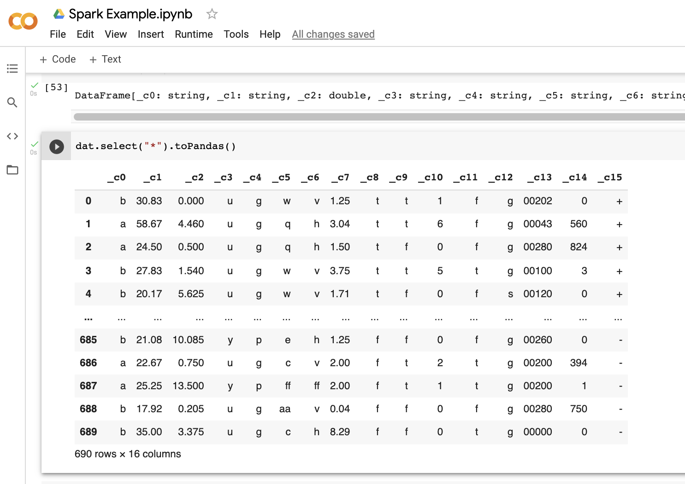
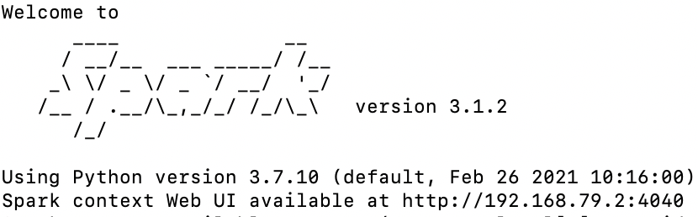
Example: Spark Notebook in Google Colab
To experiment with simple Spark commands without needing to install / setup anything on your computer, you can run Spark on Google Colab
See the simple example notebook at https://colab.research.google.com/drive/1qtNpkieNEUzyF2NnXTyqyGL3LQD1TVlI#scrollTo=pUgUMWYUKAU3

Slide 45
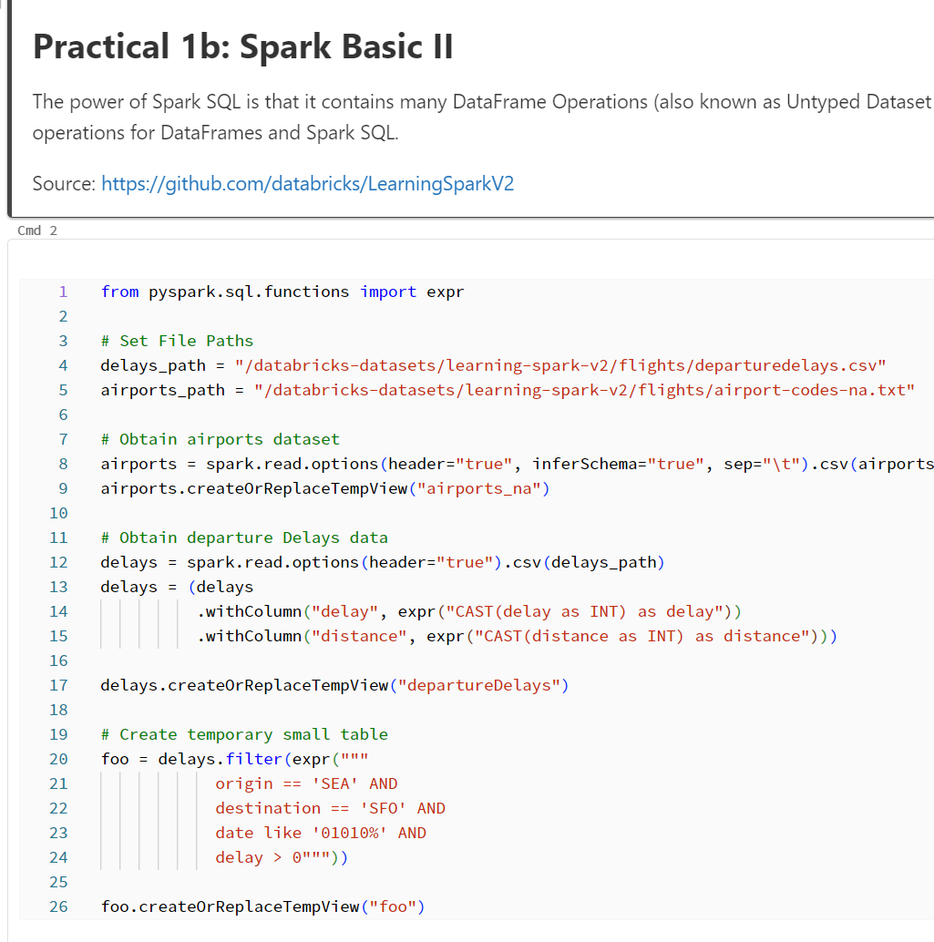
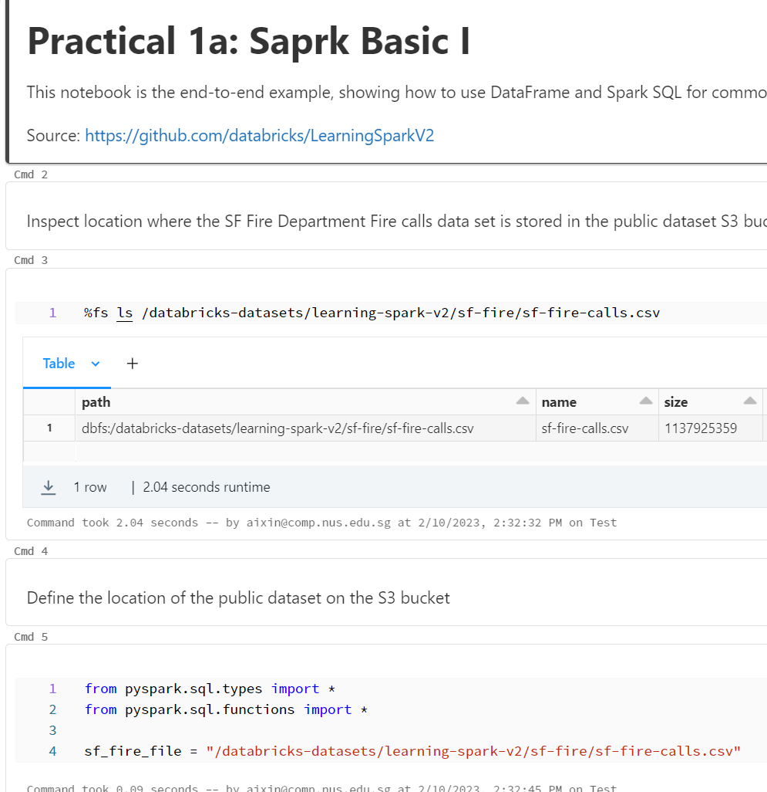
Example: Spark Notebooks in Databricks
You need to sign up a Databricks community edition account (free)
Source: https://github.com/databricks/LearningSparkV2

Slide 46
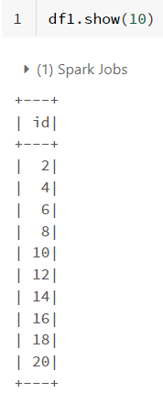
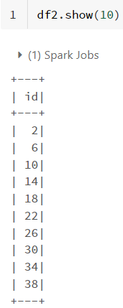
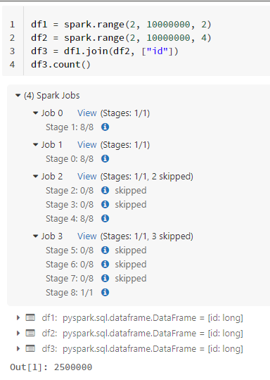
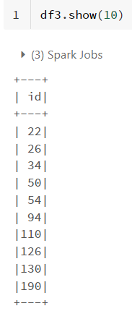
Demo_1: Spark Web UI

Slide 47
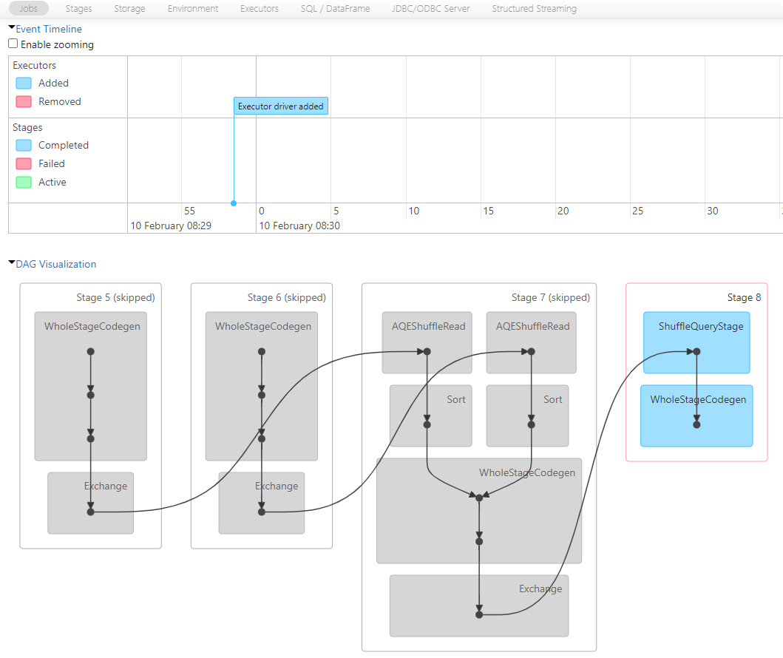

Slide 48
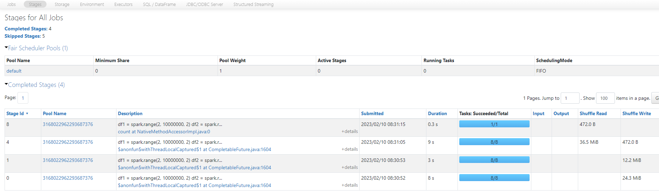
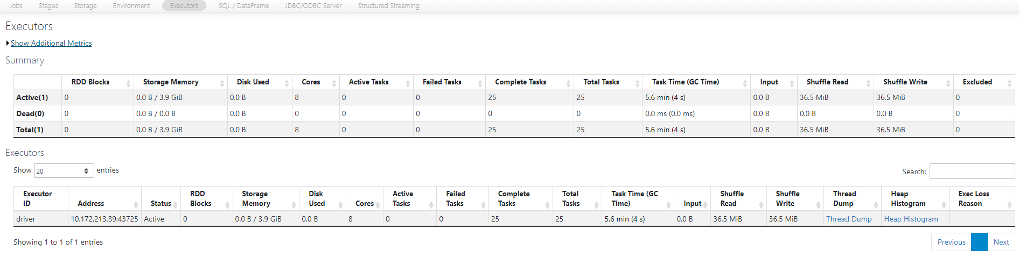

Slide 49
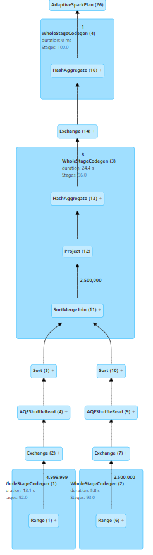
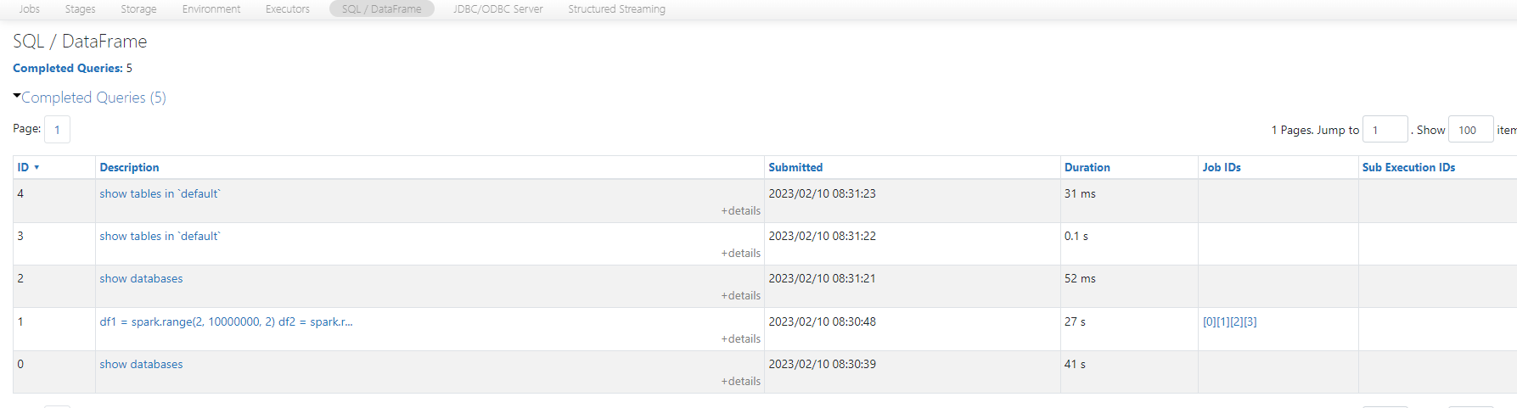
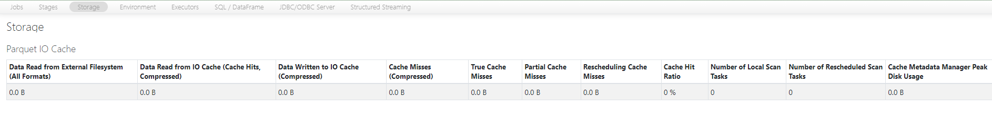
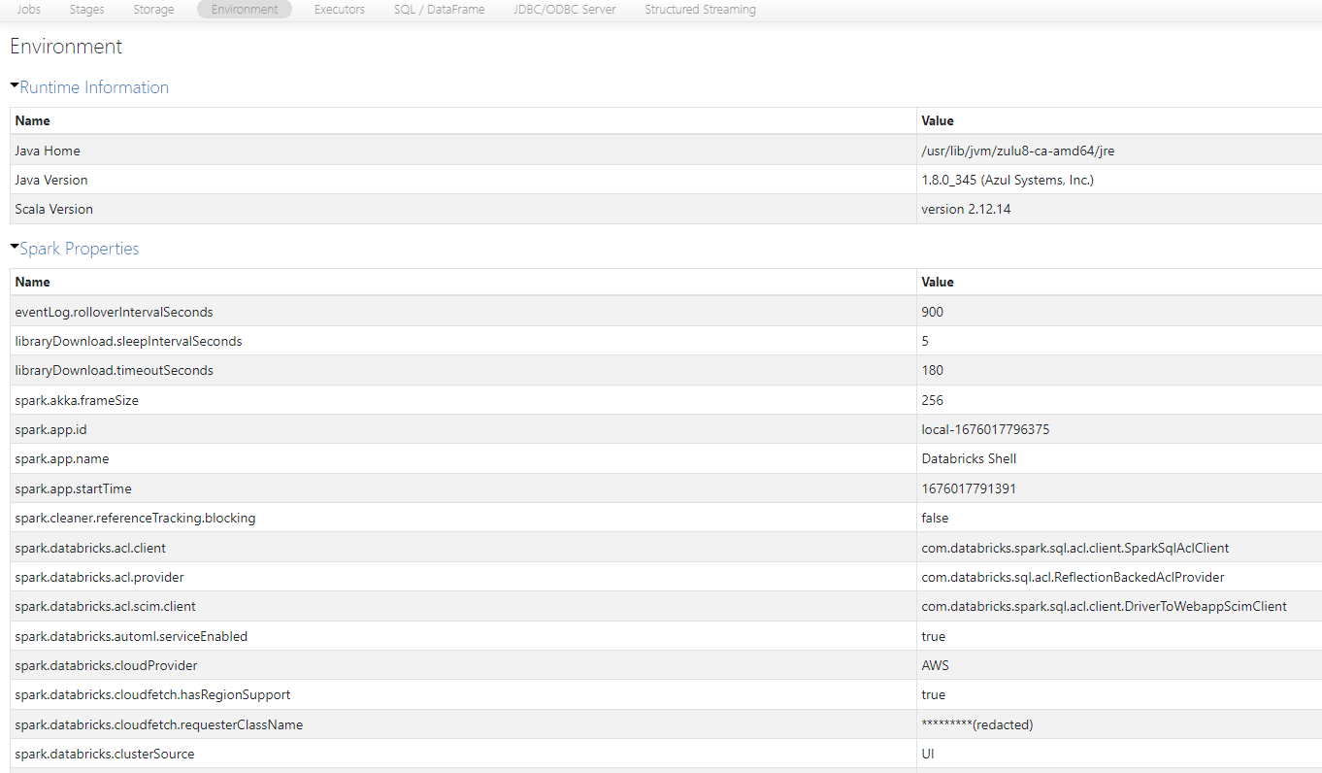

Slide 50
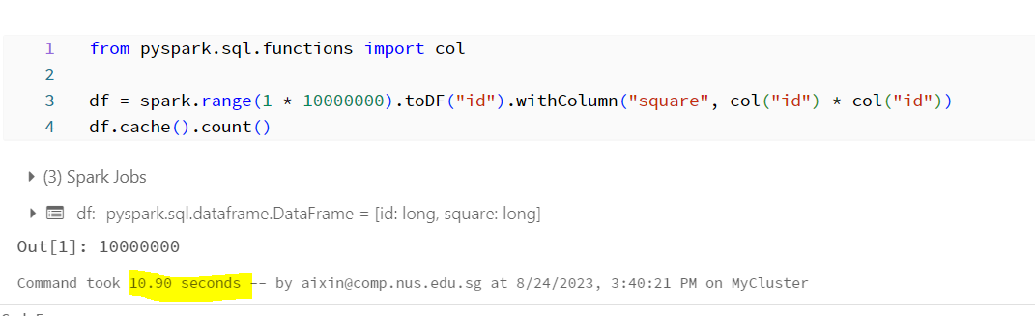
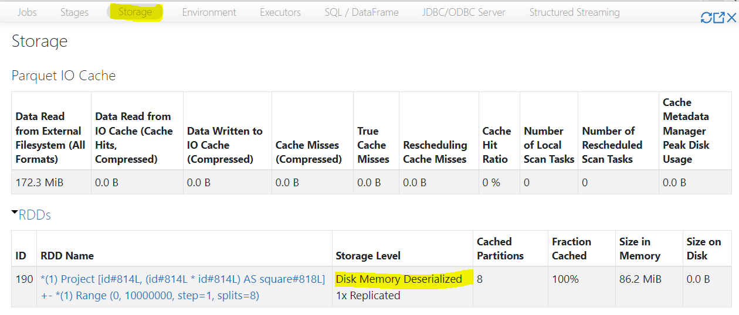
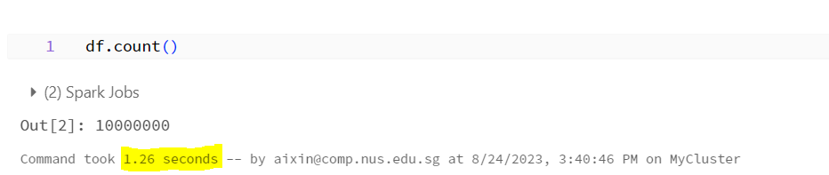
Demo_2: Caching Data
Notes:
rdd.cache(): store data as JVM objects in memory
DataFrame.cache(): store data in memory using columnar storage
applies columnar compression schemes
reduce memory footprint by an order of magnitude
particularly useful for iterative algorithms (e.g. machine learning)

Slide 51
Acknowledgements
CS4225 slides by He Bingsheng and Bryan Hooi
Jules S. Damji, Brooke Wenig, Tathagata Das & Denny Lee, “Learning Spark: Lightning-Fast Data Analytics”
Databricks, “The Data Engineer’s Guide to Spark”
https://www.pinterest.com/pin/739364463807740043/
https://colab.research.google.com/github/jmbanda/BigDataProgramming_2019/blob/master/Chapter_5_Loading_and_Saving_Data_in_Spark.ipynb
https://untitled-life.github.io/blog/2018/12/27/wide-vs-narrow-dependencies/

